Slide 1
Python - Gaming

Slide 2


Slide 3

30 Days Python Master Class
Day1 : Python
Time: 6.00 PM IST
Free Registration

Slide 4
Python Master Class
Handbook

Slide 5
NANDHINI.S
Exp: 5 Yrs
Expert in
Python Developer on Machine Learning
Deep learning with computer vision
Matlab – Image Processing
Autonomous Car design using ROS with LIDAR
Language – Python , Java , HTML ,CSS.
Tools – ANACONDA NAVIGATOR, JUPYTER NOTEBOOK,
GOOGLE COLAB.
Graduation : BE – ECE | 2011

Slide 6
Pantech?
Educational Equipment Manufacturer
IoT, AI, Robotics,Autonomous Robot
Microprocessor/Microcontroller
DSP,VLSI, Embedded System
Power Electronics & Drives, Fuel Cell Trainer Kit
Renewable Energy Lab, Electric Vehicle Lab
Technical Training
DIY Project

Slide 7

What is Master Class ?
👍 This is the 30 Days Industrial Learning Activity.
👍 Its Online YouTube Live Class
👍 If you Invest 45 minutes daily, U will become Master in Data Science
👍 You will get FREE E-Certificate
Webinar Participation Certificate
“Learning is the beginning of wealth.
Searching & Learning is where the miracle process all begins.” …………….Jim Rohn

Slide 8
Our Vision
Help 10 Million Students to Learn the Technology in Easy Way

Slide 9

Associate Partner for this Master Class
https://apssdc.in/home/

Slide 10
What U will Learn from 30 Days Data Science & Analytics Master Class

Slide 11
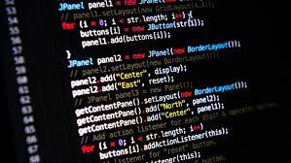




Python Learning Plan
01
02
03
04
05
Library
Python
Analytics
Analytics
Industry Project
Introduction To Python and Python Data Structures
Pandas
Numpy
MatplotLib
Cborn, SKLearn Lib
Collab
Distribution
Visualization
Aggregation
Statistics
Distribution Function
Project Building

Slide 12
Day wise Learning Plan
Day -1 : Introduction to Python
Day -2: Python – Tools|Syntaxes & Data Structures
Day -3: Python – Dictionaries,Date and Time
Day -4: Python – MySql
Day -5: Pandas library – Introduction
Day -6: Pandas library – Data Structures
Day -7: Numpy library – Introduction
Day -8: Numpy library – Array Manipulations, Mathematical Functions
Day -9: Matplotlib , Histogram Using Matplotlib | I/O With Numpy
Day -10: Matplotlib Library - Introduction , Pyplot API | Types Of Plots
Day -11: Seaborn Library
Day -12: SKLearn Library
Day -13: Python – Date and Time , Data Wrangling.
Day -14: Python – Data Cleansing
Day -15: Python – Word Tokenization , Stemming and Lammetization.

Slide 13
Day wise Learning Plan
Day -16: Python – Data Visualization
Day -17: Python – Statistical Analysis
Day -18: Python – Types Of Distribution
Day -19: Python – Correlation ,Chi-Square Test , Linear Regression
Day -20: Keras library – Introduction.
Day -21: Stock Price Prediction With Machine Learning LSTM RNN
Day -22: People’s behaviour in chat message using NLP NLP
Day -23: Gaming In Python
Day -24: Chatbot creation in Python NLP
Day -25: Electricity Price Prediction Using ML Random Forest Regressor
Day -26: Diamond Price Prediction Using Python Linear Regression
Day -27: Book Recommendation System KNN
Day -28: Image Classification Using CNN CNN
Day -29: Titanic Survival Analysis Using ML Logistic Regression
Day -30: Blockchain in Python

Slide 14
List of Projects for Demo in YouTube Live
Stock Price Prediction With Machine Learning
People’s behaviour in chat message using NLP
Gaming In Python
Chatbot creation in Python
Electricity Price Prediction Using ML
Diamond Price Prediction Using Python
Book Recommendation System
Image Classification Using CNN
Titanic Survival Analysis Using ML
Blockchain in Python
All Projects in Jupyter Notebook

Slide 15
What you will get from this Free 30 Days Master Class?
You can attend YouTube Live Class
Free E-Certificate ( WEBINAR PARTICIPATION CERTIFICATE)

Slide 16
How to mark your Attendance in YouTube Live Class?
Ans : During the Live Class, organizer will post Google Form link in Live Chat. The Participants should submit the from on daily basis. Minimum 25 Days Attendance is Required to get Free Master Class Participation Certificate.
Note : The Link will be available during the Live. From the LIVE Class date, the live video will get removed from the YouTube in 3 days.

Slide 17
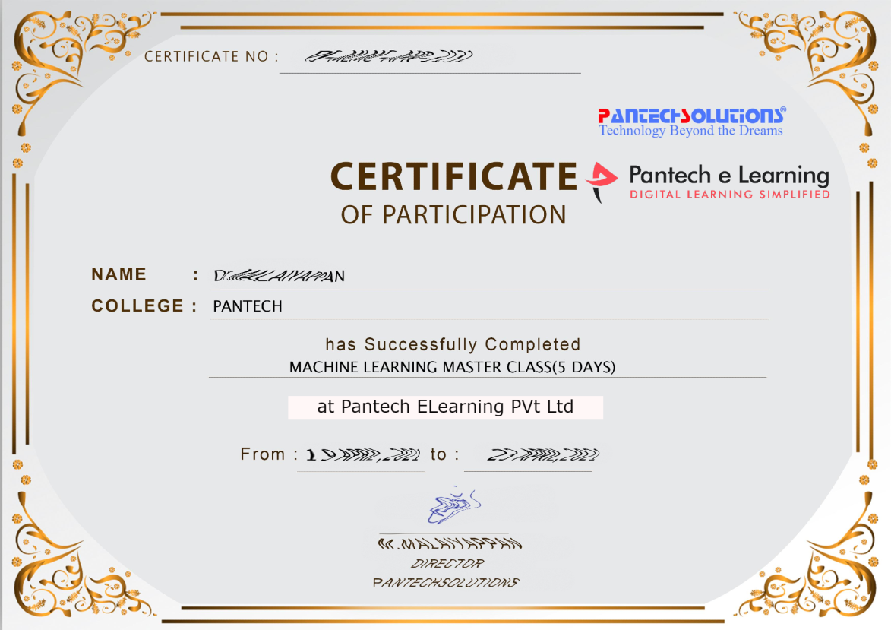

Sample Webinar Participation Certificate?

Slide 18
https://www.pantechelearning.com/data-science-master-class/
On Demand
You can get chance to apply 1 Month Internship on Data Science & Analytics Master Class

Slide 19
What is Internship????
Learn
Practice
Verify
Get Certified
Grow

Slide 20
Free Master Class DSA | 1 Month Internship on DSA
Master Class Participation Certificate | Internship Completion Certificate
Minimum 25 Class should attend YouTube Live | Recorded Class Link will be provided. – LMS Portal Access
YouTube Live Mandatory | Your Choice. You can attend Live or else You can watch Recorded Class in LMS Portal
All Projects Demo class in YouTube Live | Step by Step Video Explanation Content in LMS Portal
Access : 3 Days | VIP WhatsApp Group Support
 | You Can Download All PPTs
 | 4 Nos of Hackathon Class in Zoom Live. The Recording also will be provided
 | You Can Download All Project Files
 | Mentor will guide you to finish 10 Projects
 | Access : 60 Days

Slide 21
Pantech will make you to Create 10 Projects in Data Science & Analytics in 30 Days
Objective of this 30 Days Master Class

Slide 22
1 Month Internship in Data Science
INTERNSHIP E-Certificate(30Days Internship on Data Science Engineering)
Highly organized Video content
Download All Files
Download PPTs
Assignments
Flexible Time.
Access Period: 60Days from the date of payment

Slide 23
What You Will Get???
Complete Project Files
30 Days Learning Activity
Data Science Core Concepts
10 + Projects
Project PPT
Spatial Data Science For Covid-19 Disease Prediction
Parkinson’s Disease Prediction-XGBoost Classifier
House Price Prediction-Random Forest Regression
Customer Segmentation Using ML-K-Means Clustering
Home Loan Prediction-Decision Tree Classifier
Spam Classification-NLP
Hand Written Digit Recognition Using Python-CNN
Churn Prediction-Deep Learning
Crop Yield Prediction
Ground water level prediction
Video Class Access for 2 Months
Get chance to Enroll 1-Month Internship on demand

Slide 24

How to join in 1 month Internship
https://www.pantechelearning.com/pymc-internship/
Coupon Code: PYMC

Slide 25
Tkinter Library
This library is used for creating the GUI for desktop based applications.
Tkinter window can be created by the following steps:
Import the Tkinter module.
Create the main application window.
Add the widgets like labels, buttons , frames , etc to the window.
Call the main event loop so that the actions can take place on the user’s computer screen.

Slide 26
Example
# !/usr/bin/python3
from tkinter import *
#creating the application main window.
top = Tk()
#Entering the event main loop
top.mainloop()

Slide 27
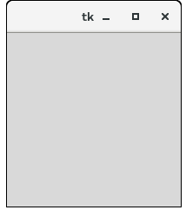
Output

Slide 28
Tkinter Widgets
Button – It is used to add various kinds of buttons to the python application.
Canvas – This widget is used to draw the canvas on the window.
MessageBox – This module is used to display the message – box in the desktop based applications.

Slide 29
Python Tkinter pack() method
The pack() widget is used to organize widget in the block.
Syntax:
Widget.pack(options)
Expand : If the expand is set to true , the widget expands to fill any space.
Fill: By default , the fill is set to none. It can be set to X or Y to determine if the widget contains any extra space.

Slide 30
Python Tkinter pack() method
Size : represents the side of the parent to which the widget is to be placed on the window.

Slide 31
Example
# !/usr/bin/python3
from tkinter import *
parent = Tk()
redbutton = Button(parent, text = "Red", fg = "red")
redbutton.pack( side = LEFT)
greenbutton = Button(parent, text = "Black", fg = "black")
greenbutton.pack( side = RIGHT )

Slide 32
Example
bluebutton = Button(parent, text = "Blue", fg = "blue")
bluebutton.pack( side = TOP )
blackbutton = Button(parent, text = "Green", fg = "red")
blackbutton.pack( side = BOTTOM)
parent.mainloop()

Slide 33
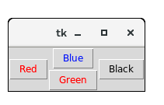
Output

Slide 34
Python Tkinter grid() method
The grid() geometry manager organizes the widgets in the tabular form.
Specify the rows and columns as the options in the method call.
We can also specify the column span(width) or the row span(height) of the widget.
Syntax:
widget.grid(options)

Slide 35
Python Tkinter grid() method
A list of possible options that can be passed inside the grid() method:
Column: The column number in which the widget is to be placed.
Columnspan: The width of the widget.
It represents the number of columns up to which , the column is expanded.
Rowspan: The height of the widget , i.e , the number of row up to which the widget is expanded.

Slide 36
Example
# !/usr/bin/python3
from tkinter import *
parent = Tk()
name = Label(parent,text = "Name").grid(row = 0, column = 0)
e1 = Entry(parent).grid(row = 0, column = 1)
password = Label(parent,text = "Password").grid(row = 1, column = 0)
e2 = Entry(parent).grid(row = 1, column = 1)
submit = Button(parent, text = "Submit").grid(row = 4, column = 0)
parent.mainloop()

Slide 37
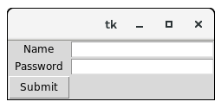
Output

Slide 38
Python Tkinter place() method
The place() geometry manager organizes the widgets to the specific x and y coordinates.
Syntax:
widget.place(options) .

Slide 39
Python Tkinter place() method
Anchor: It represents the exact position of the widget within the container.
Height,width: It refers to the height and width in pixels.
X,y: It refers to the horizontal and vertical offset in the pixels.

Slide 40
Example
# !/usr/bin/python3
from tkinter import *
top = Tk()
top.geometry("400x250")
name = Label(top, text = "Name").place(x = 30,y = 50)
email = Label(top, text = "Email").place(x = 30, y = 90)

Slide 41
Example
password = Label(top, text = "Password").place(x = 30, y = 130)
e1 = Entry(top).place(x = 80, y = 50)
e2 = Entry(top).place(x = 80, y = 90)
e3 = Entry(top).place(x = 95, y = 130)
top.mainloop()

Slide 42
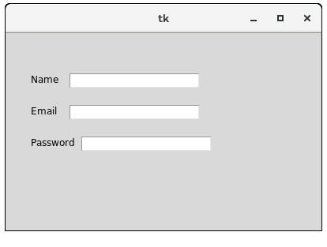
Output

Slide 43
Egg Catcher Game Using Python
It is a classic game where the goal is to catch as many eggs as possible.
In this game , every egg we catch will increase the score and if we miss three eggs , we will lose the game.

Slide 44
Egg Catcher Game Using Python
An egg catcher game tests our concentration and speed of our reflexes as we have to catch eggs falling all around the screen with one basket.
To create an egg catcher game , we have to create an animation of falling eggs at random positions and a basket will be catching the falling eggs.
To create an egg catcher game using python , first step will be to create a floor , basket and eggs.
Once the game starts, the eggs will gradually move across the floor .
It will create an animation indicating that the eggs are falling.

Slide 45
Egg Catcher Game Using Python
With the help of loops , we can check that eggs have been caught in the basket or have touched the ground.
When the egg is caught or dropped , it will be the end of an event.
Here , the egg will be removed and the game has to adjust the score by increasing the score if the egg was caught in the basket or by decreasing the one life if the egg has touched the ground.

Slide 46
Egg Catcher Game Using Python
To create an egg catcher game in python , we need to create three different loops.
One to create new eggs.
Another to check if the catcher has caught an egg.
And the third loop to move the eggs and to check if the eggs has touched the ground.

Slide 47
Egg Catcher Game Using Python
Three important modules are used to create an egg catcher game:
Itertools: to change the colours of the falling eggs.
Random: to make the eggs appear at random positions.
Tkinter: to animate the game on the screen.

Slide 48
Conclusion
The three looping functions are executed using a timer to ensure that they aren’t executed before the main loop.
Then , the mainloop() function is executed to run the egg catcher game.

Slide 49
Lives Game With Python
We are going to discuss how to create a live game in python.
In this game , we need to guess the secret word letter by letter.
If we guessed a letter incorrectly , we will lose a life.

Slide 50
Lives Game With Python
To create a live game with python , we need to write a program that shows us a mystery word with all the letters replaced by question marks.
When we have correctly guessed the letter , our program should replace the question mark with this letter.
If we know what the word is , our program should also accept the full word rather than letter by letter only.
The game should end when we have guessed the correct word or you are out of life.

Slide 51
Lives Game With Python
To create a Lives game with python , we need to create two lists , one to store the secret words and one to store the clues.
Then , using the random module , we need to make random selection from the list of our secret words.
Then , at the end , we need to run a while loop to check the player’s guesses and we also need to create a function to update the hints.

Slide 52
Creating Lives Game With Python
Import the Random module and introduce a variable to declare the number of lives.
import random
lives = 3
Create a list of secret words and then use the choice function of the random module to pick a word:
words = ['pizza', 'fairy', 'teeth', 'shirt', 'otter', 'plane']
secret_word = random.choice(words)

Slide 53
Creating Lives Game With Python
Create another list to store the clues:
clue = list('?????')
Program uses the unicode heart character to indicate the number of lives remaining.
To make our code easier to read , we need to store a core Unicode in a variable.
heart_symbol = u'\u2764'

Slide 54
Creating Lives Game With Python
We need to introduce a new variable to store whether or not a player has guessed the word correctly.
guessed_word_correctly = False
We need to create a function to update the clues:

Slide 55
Creating Lives Game With Python
def update_clue(guessed_letter, secret_word, clue):
index = 0
while index < len(secret_word):
if guessed_letter == secret_word[index]:
clue[index] = guessed_letter
index = index + 1

Slide 56
Creating Lives Game With Python
Write the main code of the lives game with python.
We need to ask for user input to guess the correct letter or the word.

Slide 57
Creating Lives Game With Python
while lives > 0:
print(clue)
print('Lives left: ' + heart_symbol * lives)
guess = input('Guess a letter or the whole word: ')
if guess == secret_word:
guessed_word_correctly = True
break

Slide 58
Creating Lives Game With Python
if guess in secret_word:
update_clue(guess, secret_word, clue)
else:
print('Incorrect. You lose a life')
lives = lives - 1

Slide 59
Creating Lives Game With Python
In the end , we need to check if the player has won or lost.
if guessed_word_correctly:
print('You won! The secret word was ' + secret_word)
else:
print('You lost! The secret word was ' + secret_word)

Slide 60
Egg Catcher Game
An egg catcher game tests your concentration and the speed of your reflexes as you have to catch eggs falling all around the screen with one basket.
To create an egg catcher game you have to design an animation of falling eggs at random positions and a basket will be catching all the falling eggs.
To create an eggs catcher game using Python, your first step will be to design a floor, basket, and eggs.
Once your game starts, the eggs will gradually move across the floor, which will create an animation indicating that the eggs are falling.

Slide 61
Egg Catcher Game
Then with the help of loops, we can constantly check that the eggs have been caught in the basket or have touched the ground.
When the egg is caught or dropped, it will be an end of an event, so here the egg will be removed and the game has to adjust the score by increasing the score if the egg was caught in the basket or by decreasing your one life if the egg has touched the ground.

Slide 62
Egg Catcher Game Using Python
To create an egg catcher game in python , three different loops are required:
One to create eggs.
Another to check if the catcher has caught an egg.
And the third loop to move eggs and check if the eggs has touched the ground.

Slide 63
Egg Catcher Game Using Python
itertools: to change the colours of the falling eggs.
random: to make the eggs appear at random positions.
Tkinter: to animate the game on the screen.

Slide 64
Caterpillar Game With Python
To make a caterpillar game with python you need to develop a logic in which you will use the four arrow keys to move around the caterpillar to make it eat the leaf, every time it eats the leaf it will grow bigger and move around faster.
You have to keep the caterpillar inside the widow otherwise the game will be over.
The more leaves the caterpillar eats, it will make the game difficult to play as the caterpillar will get bigger and move faster, which means you will have to play with the arrow keys faster.

Slide 65
Caterpillar Game With Python
To create this game in python , turtle module is used.
Two turtles are being used , one to draw the caterpillar and one to draw the leaf.
We need to program the two turtle objects so that one increases in size every time it comes in contact with the leaf and moves faster and the other appears in a random position every time the caterpillar eats leaf.

Slide 66
Caterpillar Game With Python
To make the crawler game with Python, the biggest challenge is knowing how to move it around the screen.
To move it around the screen , use an infinite loop.
Each time the loop goes around, the caterpillar moves forward slightly.
When the loop repeats quickly, these small movements will create the illusion that the caterpillar is crawling.

Slide 67
Caterpillar Game With Python
Following steps are used for creating a caterpillar game.
Start by setting the properties of leaf and the caterpillar.
Set the starting values like the speed and size of the caterpillar at the start of the game and the score of the game.
Program the caterpillar to move forward , use the if and else statements , to check if the caterpillar has made contact with the leaf or not.

Slide 68
Caterpillar Game With Python
If the caterpillar has not made contact with the leaf we will check that whether it has left the screen or not, if it has left the screen we will stop the game and show the game over.
If the caterpillar has now left the screen we will move the leaf in a now random position and increase the size of the caterpillar and increase the score.
And keep repeating this process.

